Slide 1
Bomberman Java Game

Slide 2
Group Member
Nguyễn Thị Thanh Thảo – ITITIU20310
Trịnh Thị Như Quỳnh– ITITIU20291
Đàng Thành Mai Thi– ITITSB20006
Nguyễn Đoàn Minh Khoa- ITITIU20231
Mai Văn Hưng– ITITIU20209

Slide 3
1. Gameplay

Slide 4
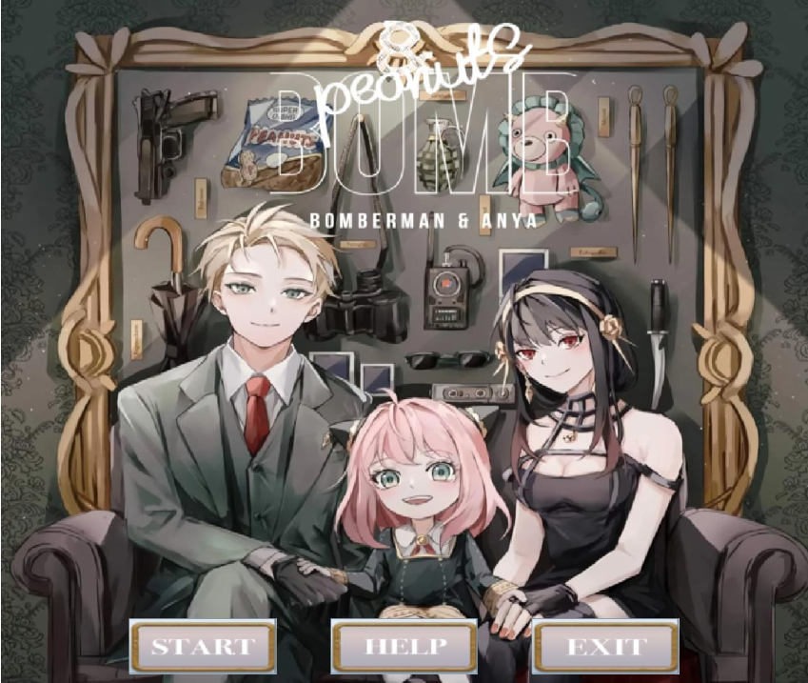
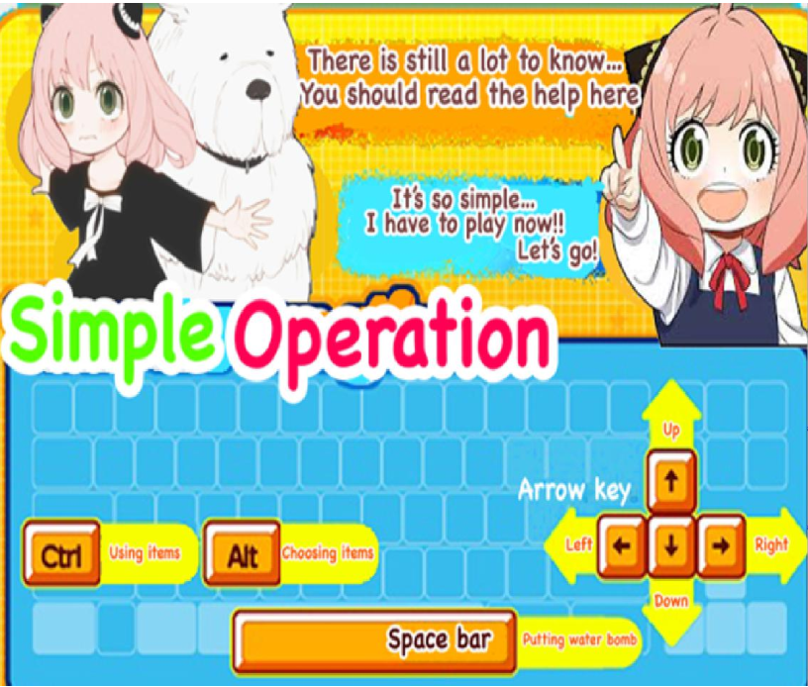
Game menu and game guide
Play Game
Quit Game

Slide 5
How to play?
Players will direct the character’s movement in order to place bombs to killing the enemy. After the player has killed all of the monsters the game will be end.

Slide 6

Character:
Character: The character is controlled by the arrow key combination, only one bomb can be placed at a time.
The character will gain speed change if the value is Speed Item.

Slide 7
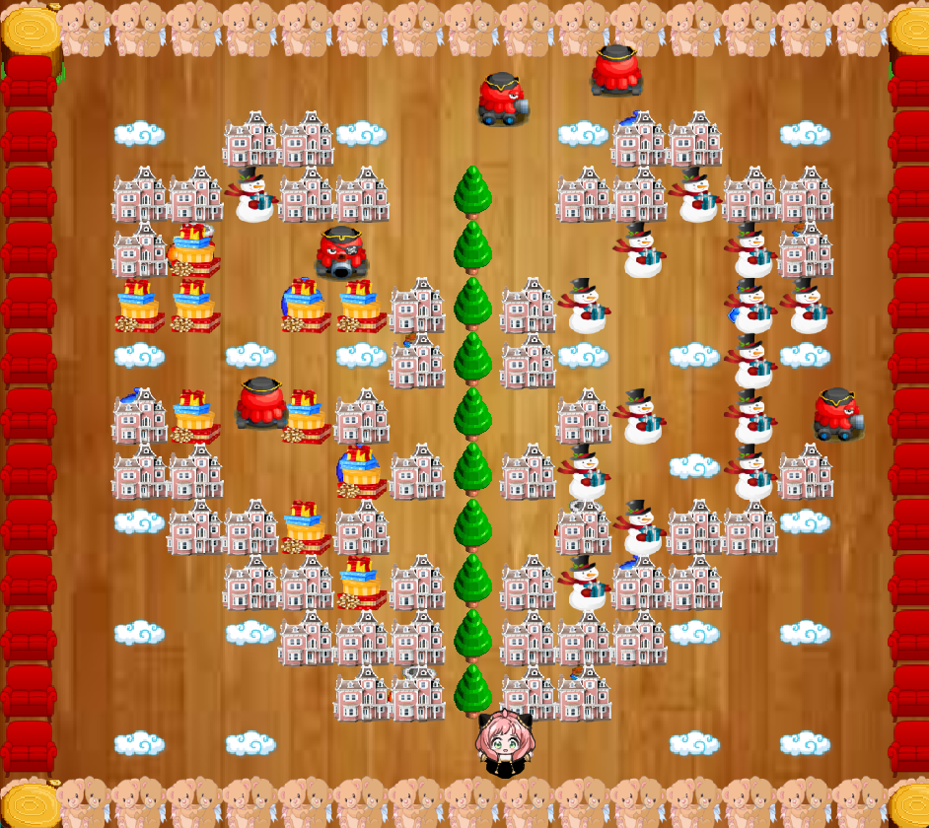
Character:
Default in Character
When start the game Character will be spawn at nearly bottom of the map
The character will get 2 number of boom, and it will increase when player get boom item.

Slide 8

Character:
There are some effects on the character to make player feel bustling and excited.

Slide 9

Character:
Set Boom: When player pressed Space key, the boom will appear at the character’s feet.
The collision was arranged after the character stepped out of the set boom zone. Meaning the character won't be able to go through the boom

Slide 10

Character:
Player can be killed by enemy and boom when it collides with the enemy and boom explosions.

Slide 11

Game Over

Slide 12




Enemy:
Each enemy has its own AI, which is used by the random function so that the character can move.
Also set the random function to spawn enemy in the map. There are 5 enemy will spawn on the map.

Slide 13

Boom
When the bomb explodes, it will create a fire trail, if the character or the enemy hits the fire trail, they will all be destroyed. The length of the flame will increase if the character eats the special items

Slide 14





Boom explosion
The length wave of boom explosion is very small, only 1 rectangle for one vertical and horizontal
If Character get potion item, it could increase the size of length wave

Slide 15






Map Blocks
Gift and doll house: It can be broken by bombs and can contains items.
Sofa, tree ,cloud and teddy bear it cannot be broken to limit the movement of characters and enemies

Slide 16



Special Item
Bomb item: The character will increase the number of bomb they have.
Shoes: The character will gain high speed
Potion: The length wave of bomb explosion will be increase

Slide 17
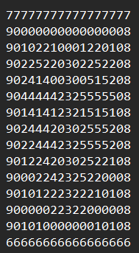
Map Data Design (Map01.txt)
1: Cloud
2: Dollhouse
3: Tree
4: Gifts
5: Snow
6: Bear
7: Bear
8: Sofa
9: Sofa

Slide 18
Advantages:
The game is easy to play, friendly to everyone
Smooth movement
Players experience the feeling of childhood

Slide 19
2. Game Setting
Language: Java
Framwork: IntelliJ, Visual Studio Code, Eclipse

Slide 20
Control

Slide 21
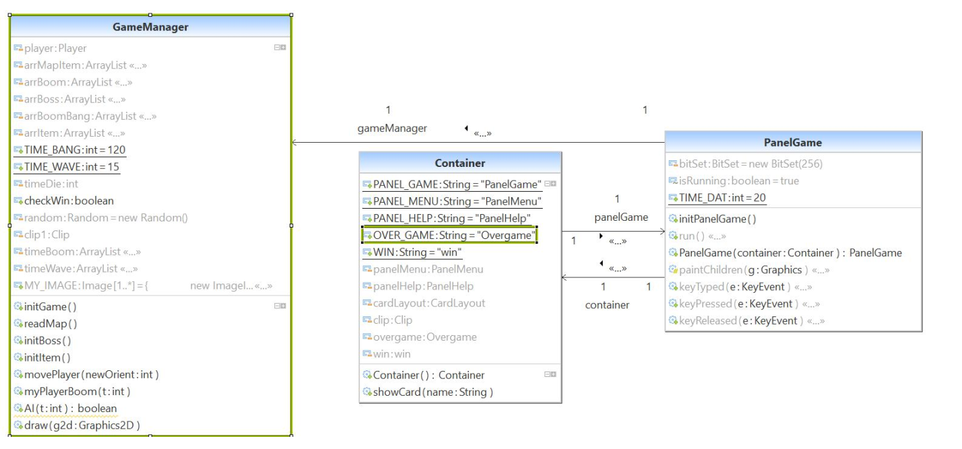
Game Panel

Slide 22
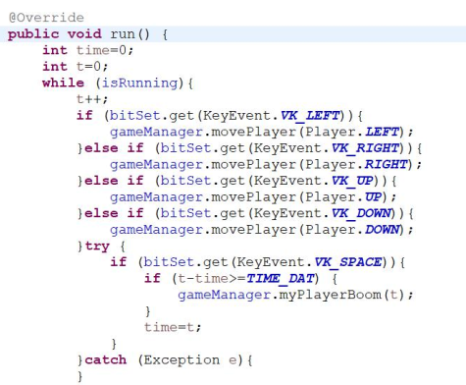
Controller
The run() in Game Panel is controlled Character base on input( Up, Down, Left, Right) from the keyboard, checking the conditions for placing bombs, including: whether to receive a bomb signal from the player ( _input. space ), the time between two bombs, it also directs the win panel and the game over panel when player lose or win.

Slide 23
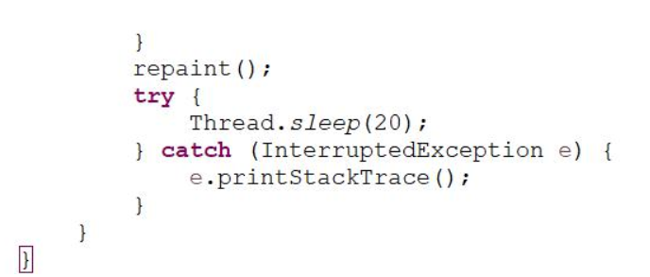
Controller
The try-catch statements handles any exceptions that may occur. The "thread.sleep" is to wait 20 ms before calling move so that all the objects are completely created.

Slide 24
Controller
AI helps the boss automatically move
With AI the simplest is go to random, orient classes to return random values.
Specifying the return integer value corresponding to which direction is up to you to decide in function initBoss()

Slide 25
Button Control

Slide 26
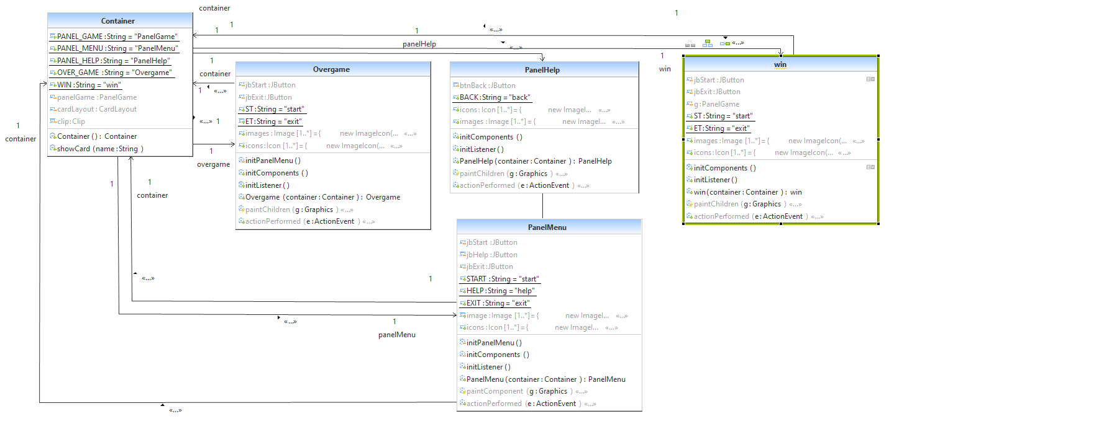
UML diagram of button controller

Slide 27
Button Controller
This class presents the menu game with three buttons(Start, Help, Exit) for players to begin the games
PanelGame class:
PanelHelp class:

Slide 28
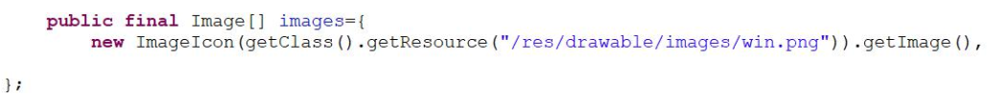
Button Controller
This class presents the menu game with three buttons(Start, Help, Exit) for players to begin the games
Win class:
OverGame class:

Slide 29
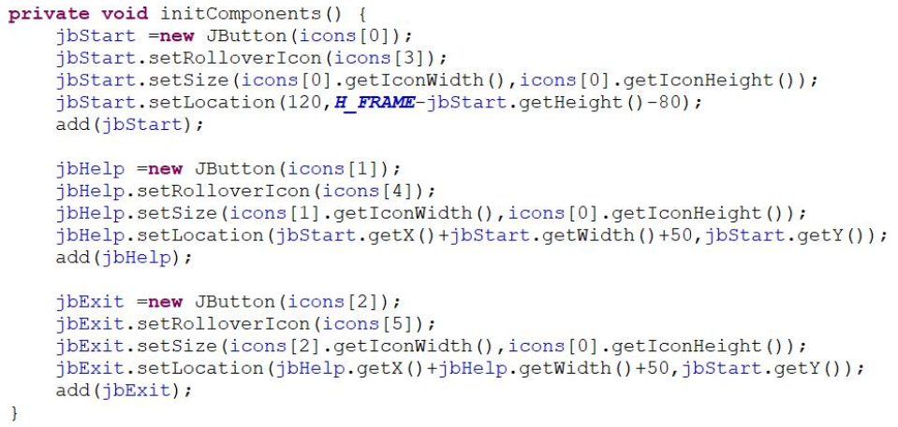
Button Controller
The initComponents()will set the size, the location and add images of button on menu background.
PanelGame class:

Slide 30
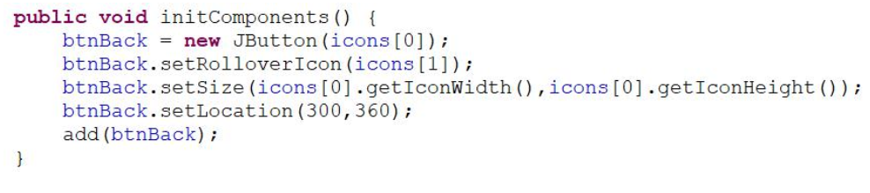
Button Controller
The initComponents()will set the size, the location and add images of button on menu background.
PanelHelp class:

Slide 31
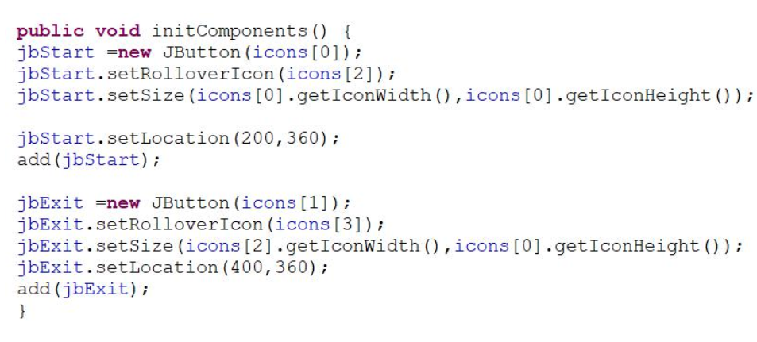
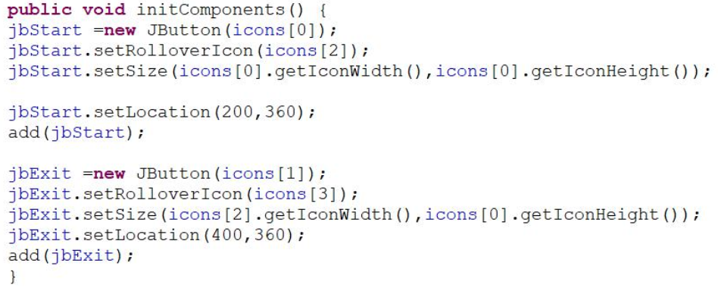
Button Controller
The initComponents()will set the size, the location and add images of button on menu background.
Win class
GameOver class

Slide 32
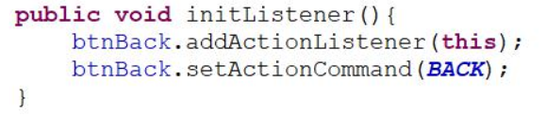
initListener():
The initListener() is used when player click any button and it works depend on the package java.awt.event.ActionListener
ActionListener in Java is a class that is responsible for handling all action events such as when the user clicks on a component.
PanelHelp class:

Slide 33
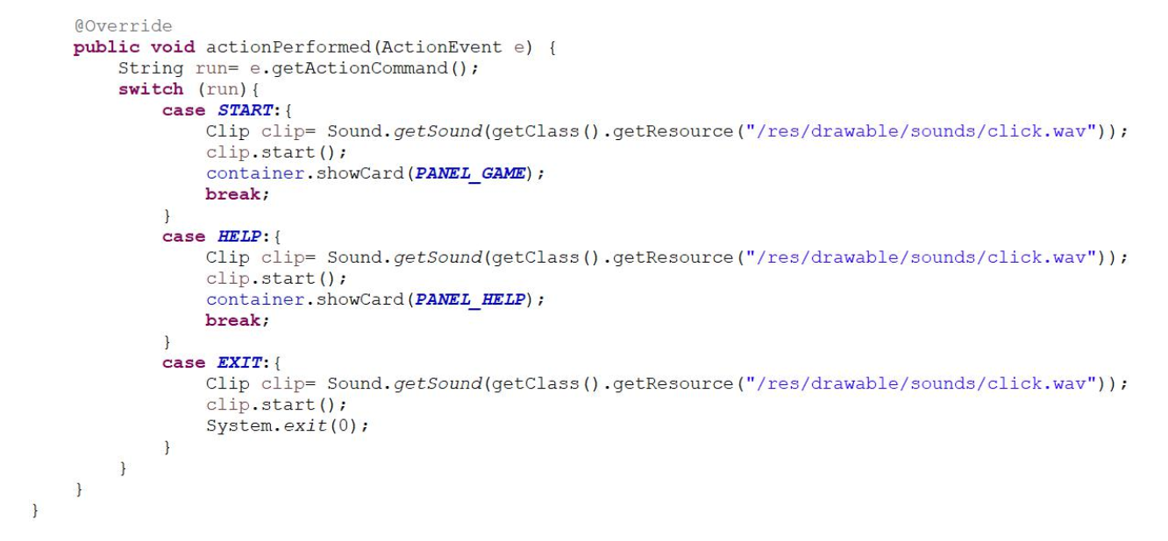
initListener():
It also handles each functionally of each button:

Slide 34
Sound

Slide 35
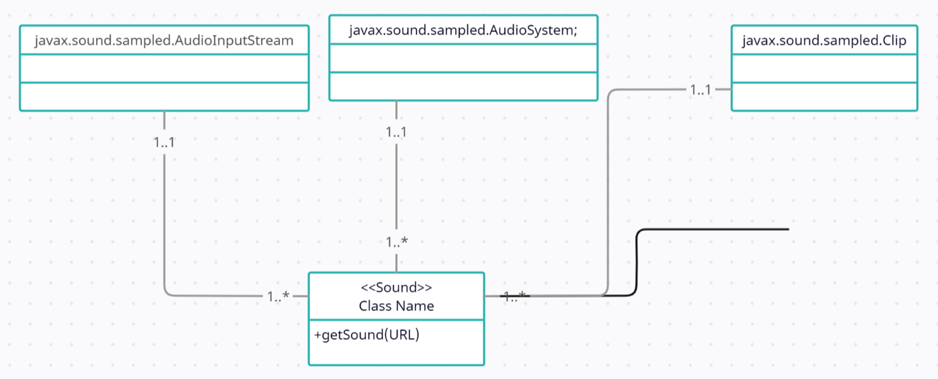
Sound

Slide 36
Sound
Sound: is control by class sound which can add sounds to the game, including background sounds and the sounds of in-game events (bombs exploding, characters dying, winning, eating items, etc.).
Note that the background sound and the event are independent of each other, ie playing the event sound does not affect the background sound.

Slide 37
Player and Enemy

Slide 38
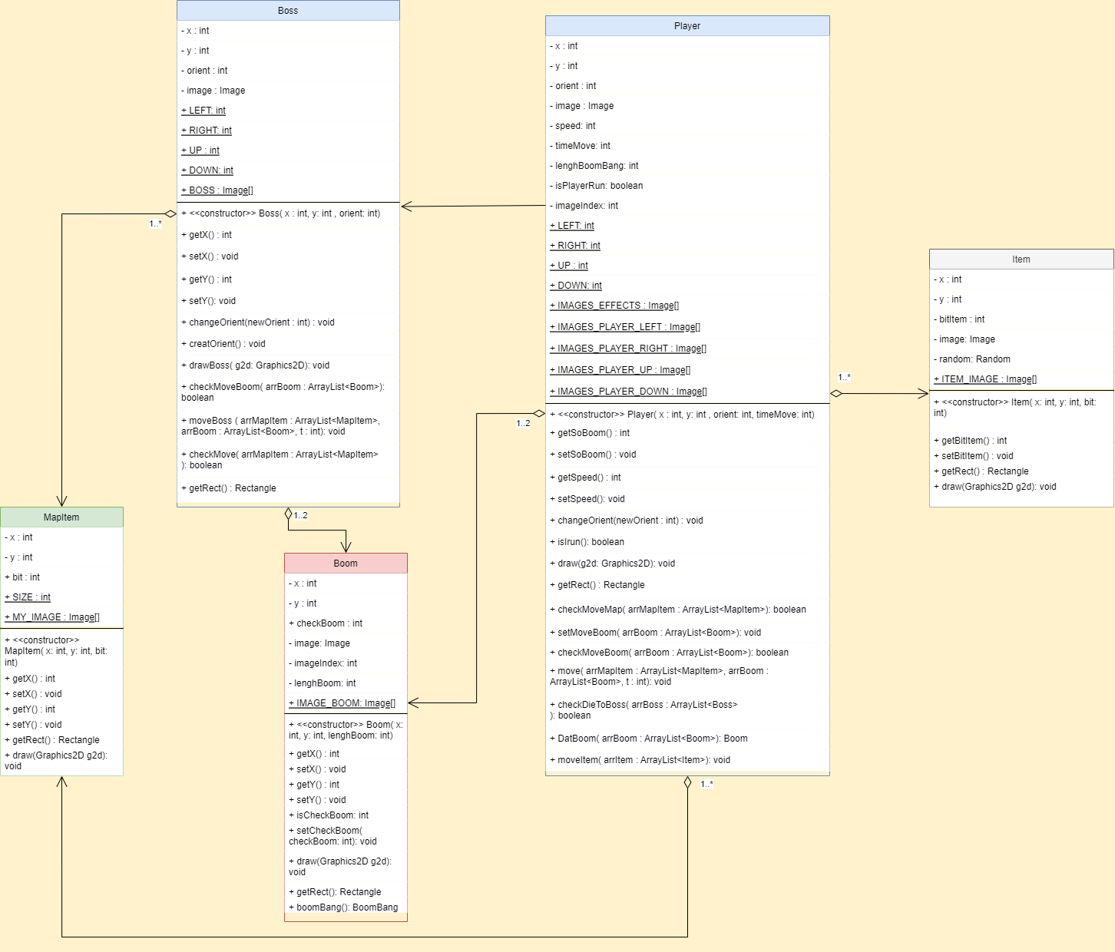
UML Diagram for Player and Boss Class

Slide 39
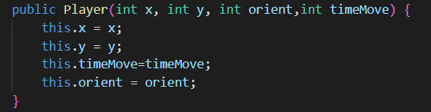
Player Class
Player: <<constructor>>
-> Set the default position of the character.

Slide 40
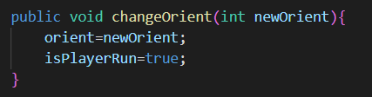
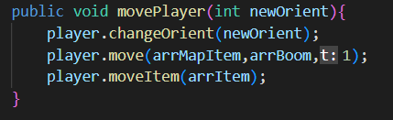
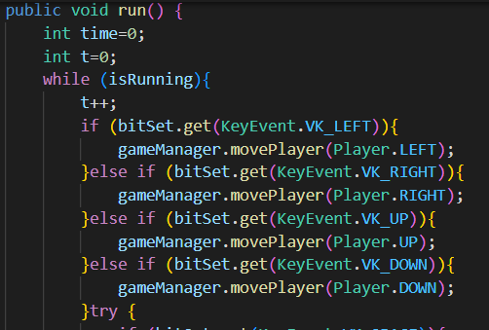
Player Class
changeOrient()

Slide 41
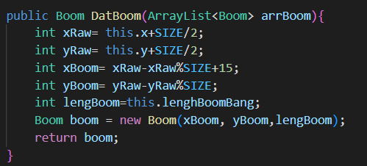
Player Class
Bomb setter:
-> To set the Boom position at the character’s feet

Slide 42
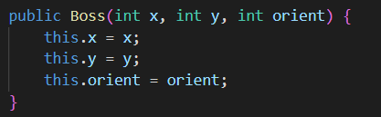
Boss Class:
Boss <<constructor>>
-> Set the location of the boss using randomly on the map

Slide 43
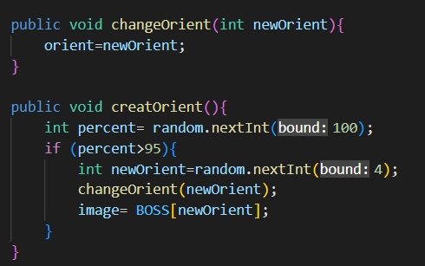
Boss Class:
Simple AI for Boss to move:

Slide 44
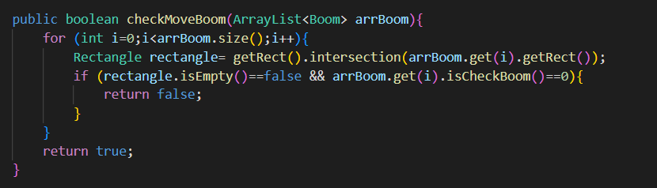
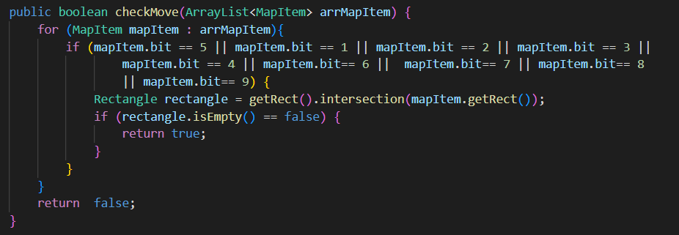
Boss Class:
Collision checker:

Slide 45
Boom and boombang class

Slide 46
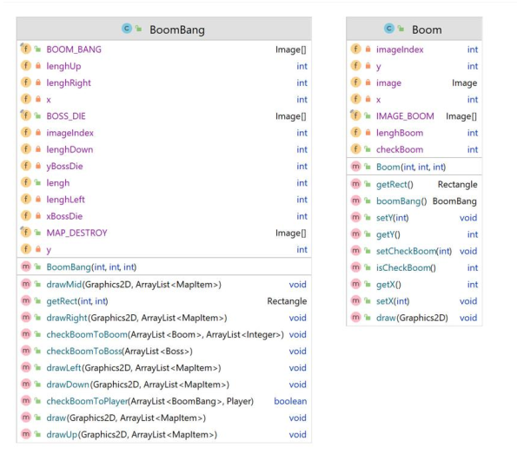
UML diagram for Boom and boom explosion:

Slide 47
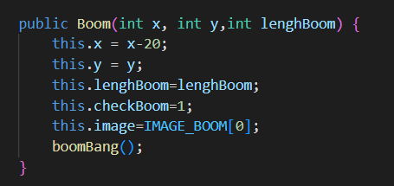
Boom class:
Boom <<constructor>>:
-> To set the default position of Boom, which is at the character’s feet

Slide 48
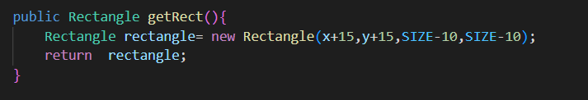
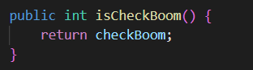
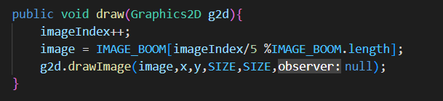
Boom class:
The size of boom
Time for boom explode
draw function

Slide 49
Boombang Class:
BoomBang constructor
-> Sets the position of the Boombang equals to Boom
Domino effect
-> The boom will explode if the nearly boom exploded
Boom explode to boss and player
-> Player or boss will be dead if the boom explode in range

Slide 50
Mapitem and item class

Slide 51
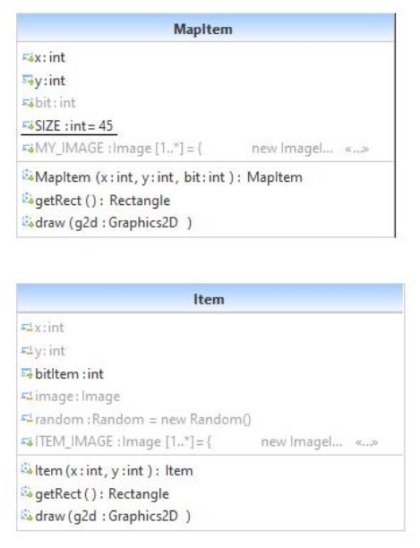
UML Diagram for Map and mapitem:

Slide 52
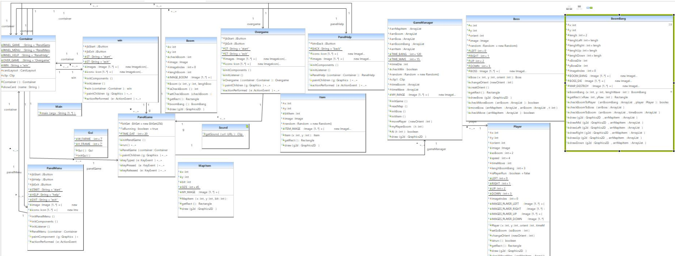
Game Logical design as UML Diagram:

Slide 53
Logical Design:
Killed All Enemy
Quit
Play
Game Panel
Restart
Player Die

Slide 54
References:
phuctd99
Oracial java
MarioTran
JavaFx Tutorial
A* Intelligent

Slide 55
Demonstrate

Slide 56
Thanks!
Do you have any questions?

